Slide 1
Features Engineering

Slide 2
Feature Engineering
Feature Transformation
Feature construction-
Feature Extraction
Feature Subset Selection

Slide 3
Feature construction-
Process of discovers missing information about the relationships between features and augment the feature space by creating additional features
If n features in dataset ,after feature construction m more features added.
Now data set with m+n features.

Slide 4
Feature Construction-Encoding categorical(Nominal ) variables
Example:
The city where a person lives: Delhi, Mumbai, Ahmedabad, Bangalore, etc.
The department a person works in: Finance, Human resources, IT, Production.

Slide 5
One Hot Encoding
We use this categorical data encoding technique when the features are nominal(do not have any order).
In one hot encoding, for each level of a categorical feature, we create a new variable. Each category is mapped with a binary variable containing either 0 or 1. Here, 0 represents the absence, and 1 represents the presence of that category.

Slide 6
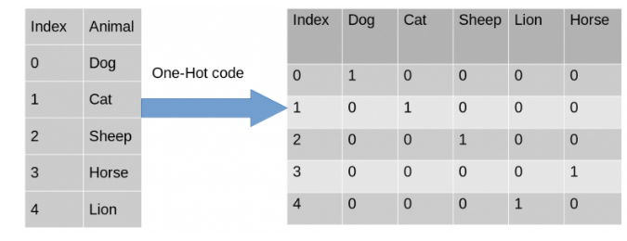

Slide 7
Feature Construction-Encoding categorical(Ordinal ) variables
In Label encoding, each label is converted into an integer value.
Marks | Grade
90 | A+
87 | A
66 | B
54 | C

Slide 8
Ordinal data: This type of categorical data consists of a set of orders or scales. For example, a list of patients consists of the level of sugar present in the body of a person which can be divided into high, low and medium classes.

Slide 9
Label Encoding or Ordinal Encoding
Marks | Grade
90 | 1
87 | 2
66 | 3
54 | 4

Slide 10
Transforming numeric features into categorical features
Text Specific feature construction

Slide 11
Feature extraction
Feature extraction is the process of extracting or creating a new set of features from the original set of features using some functional mapping.

Slide 12
Feature extraction
For Boolean features: Conjunctions, Disjunctions, Negation, etc.
For nominal features: Cartesian product, M of N, etc.
For numerical features: Min, Max, Addition, Subtraction, Multiplication, Division, Average, Equivalence, Inequality, etc.

Slide 13
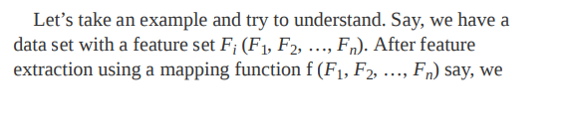
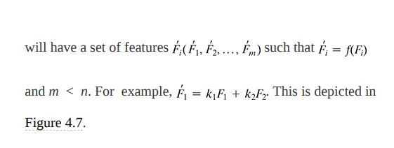
Feature extraction

Slide 14
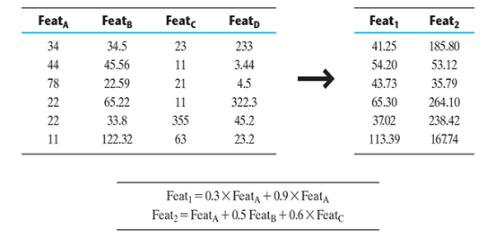
Feature extraction

Slide 15
Advantages
Accuracy improvements.
Overfitting risk reduction.
Speed up in training.
Improved Data Visualization.
Increase in explainability of our model.

Slide 16
PCA
Principal component analysis, or PCA, is a dimensionality reduction method that is often used to reduce the dimensionality of large data sets, by transforming a large set of variables into a smaller one that still contains most of the information in the large set.

Slide 17
the idea of PCA is simple — reduce the number of variables of a data set, while preserving as much information as possible.

Slide 18
Step-by-Step Explanation of PCA
STEP 1: STANDARDIZATION
STEP 2: COVARIANCE MATRIX COMPUTATION
STEP 3: COMPUTE THE EIGENVECTORS AND EIGENVALUES OF THE COVARIANCE MATRIX TO IDENTIFY THE PRINCIPAL COMPONENTS
Step 4:Sorting the Eigen Vectors
Step 5:Calculating the new features Or Principal Components
Step 6:Remove less or unimportant features from the new dataset.

